Slide 1
Hypothesis Testing: Citi Bike System Data
Ahmaad Jackson

Slide 2
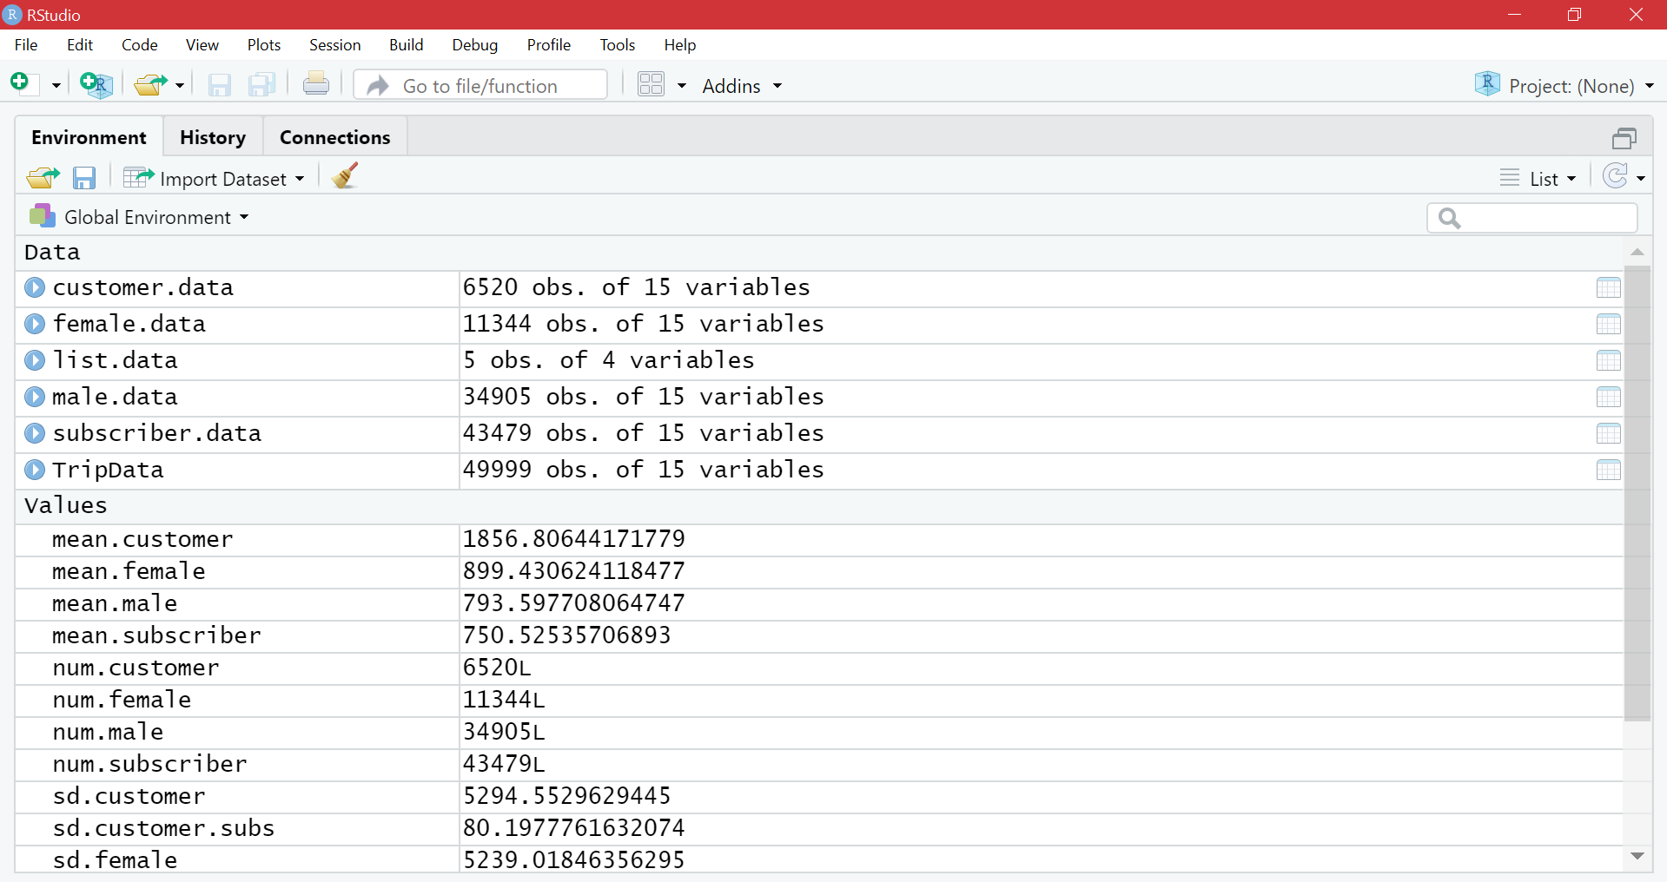
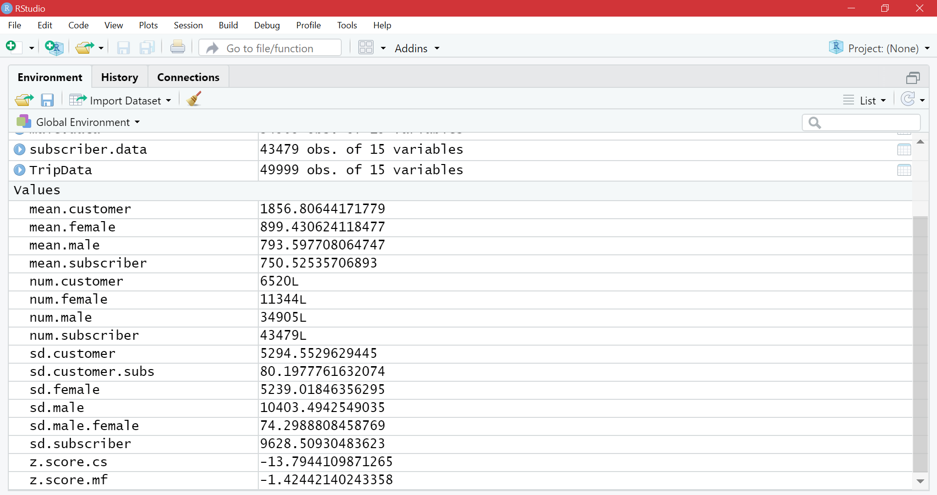
The Data
More subscribers, & more men observed
Larger deviations in subscribers & men compared to customers & women

Slide 3
Hypothesis Test 1
Null Hypothesis: Subscribers ride the same duration (on average) as customers
Alternate Hypothesis: Subscribes ride a longer duration (on average) than customers

Slide 4
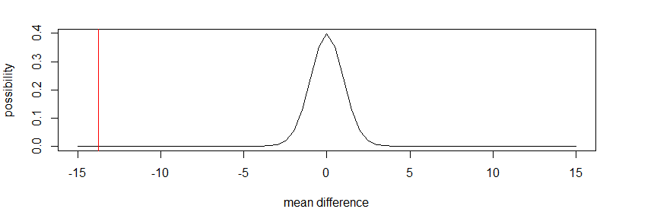
Explanation for Test 1
This is an upper-tailed test, with a negative test statistic
P = 1; We cannot reject the null hypothesis
Subscribers do not ride a longer duration on average than customers

Slide 5
Hypothesis Test 2
Null Hypothesis: Men ride the same duration (on average) as women
Alternate Hypothesis: Men ride a longer duration (on average) than women

Slide 6
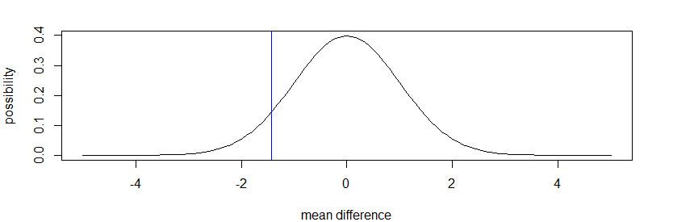
Explanation for Test 2
This is an upper-tailed test, with a negative test statistic
P = 0.922; We cannot reject the null hypothesis
Men do not ride a longer duration on average than women

Slide 7
Conclusion
The opposite results of our test was true
Customers on average traveled a longer distance than subscribers (Even though there were more subscribers)
Females on average traveled a longer distance than men (Even though there were more males observed)
Our results seem to indicate that bike share systems (such as Citi Bike) should target their product towards people who use their services for a short amount of time, not towards annual users
Also market towards women more, as the results show that they travel longer distances on the bike
However, this data may not be truly accurate because there was a significant difference in the amount of observers between men & women, & between customers & subscribers

